Slide 1



Spring Framework - AOP
SPRING FRAMEWORK 3.0
Aspect Oriented Programming with Spring

Slide 2




Aspect Oriented Programming
Spring Framework - AOP

Slide 3

What is AOP?
is a programming paradigm
extends OOP
enables modularization of crosscutting concerns
is second heart of Spring Framework
Spring Framework - AOP

Slide 4
A simple service method
public Order getOrder(BigDecimal orderId) { return (Order) factory.openSession() .get(Order.class, orderId); }
Spring Framework - AOP

Slide 5
Add permissions check
public Order getOrder(BigDecimal orderId) {
if (hasOrderPermission(orderId)) { return (Order) factory.openSession() .get(Order.class, orderId);
} else {
throw new SecurityException("Access Denied");
} }
Spring Framework - AOP

Slide 6
Add transaction management
public Order getOrder(BigDecimal orderId) {
if (hasOrderPermission(orderId)) { Order order; Session session = factory.openSession(); Transaction tx = session.beginTransaction(); try { order = (Order) session.get(Order.class, orderId); tx.commit(); } catch (RuntimeException e) {if (tx!=null) {tx.rollback();} } finally {session.close();} return order;
} else { throw new SecurityException("Access Denied");}
}
Spring Framework - AOP

Slide 7
Add cache
public if
Order getOrder(BigDecimal orderId) { (hasOrderPermission(orderId)) { Order order = (Order)cache.get(orderId); if (order==null) { Session session = factory.openSession(); Transaction tx = session.beginTransaction();
try { order = (Order) session.get(Order.class, orderId); tx.commit(); cache.put(orderId, order); } catch (RuntimeException e) {if (tx!=null) {tx.rollback();} } finally {session.close();} }
return order;
} else { throw new
SecurityException("Access Denied");}
}
Spring Framework - AOP

Slide 8
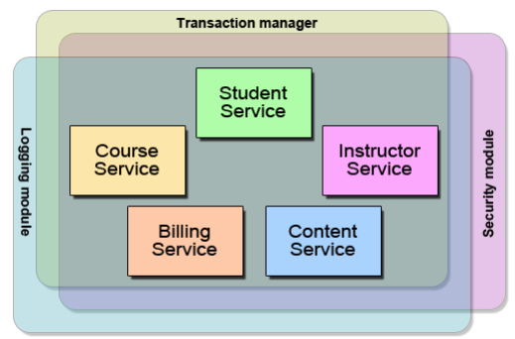
A similar problem at enterprise level
Spring Framework - AOP

Slide 9

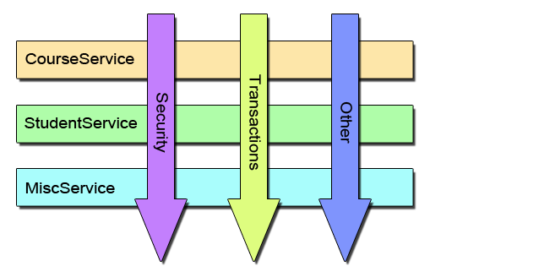
What does AOP solve?
Logging
Validation
Caching
Security
Transactions
Monitoring
Error Handling
Etc…
Spring Framework - AOP

Slide 10
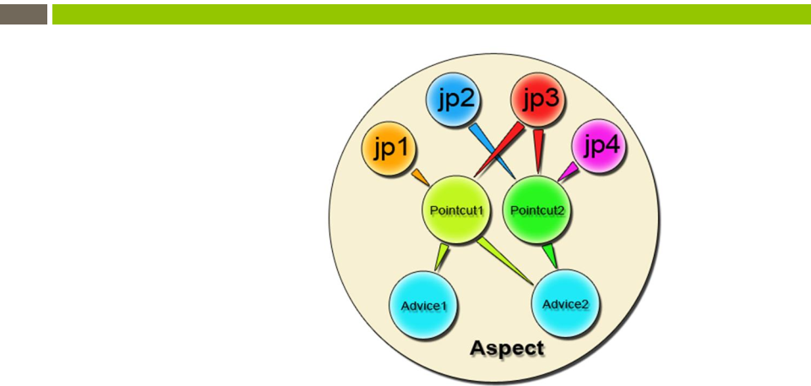
AOP concepts
aspect
advice
pointcut
join point
Spring Framework - AOP

Slide 11


AOP and OOP
AOP
OOP
1.
2.
3.
4.
Aspect – code unit that encapsulates pointcuts, advice, and attributes
Pointcut – define the set of entry points (triggers) in which advice is executed
Advice – implementation of cross cutting concern
Weaver – construct code (source or object) with advice
1.
2.
3.
4.
Class – code unit that encapsulates methods and attributes
Method signature – define the entry points for the execution of method bodies
Method bodies –implementation of the business logic concerns Compiler – convert source code
to object code
Spring Framework - AOP

Slide 12
AOP concepts(2)
introduction
target object
AOP proxy
weaving
compile time
load time
runtime
Spring Framework - AOP

Slide 13
Spring AOP
implemented in pure java
no need for a special compilation process
supports only method execution join points
only runtime weaving is available
AOP proxy
JDK dynamic proxy
CGLIB proxy
configuration
@AspectJ annotation-style
Spring XML configuration-style
Spring Framework - AOP

Slide 14
@AspectJ
Spring Framework - AOP

Slide 15
Declaring aspect
@Aspect
public class EmptyAspect {
}
<!--<context:annotation-config />-->
| true"/>
<bean class="org.springframework.aop.aspectj.annotation.AnnotationAwareAspectJAutoProxyCreator"> </bean>
<bean class="example.EmptyAspect"/>
Spring Framework - AOP

Slide 16
Declaring pointcut
Spring Framework - AOP

Slide 17
Pointcut designators
code based execution within target this args bean
Spring Framework - AOP

Slide 18
Pointcut designators(2)
annotation based @annotation @within @target @args
Spring Framework - AOP

Slide 19
Format of an execution expression
execution( modifiers-pattern
returning-type-pattern
declaring-type-pattern
name-pattern(param-pattern)
throws-pattern )
Spring Framework - AOP

Slide 20
Simple pointcut expressions
@Aspect
public class
ItemStatusTracker {
@Pointcut("execution(* approve(..))") public void ifApprove() {}
@Pointcut("execution(* reject(..))") public void ifReject() {}
@Pointcut("ifApprove() || ifReject()") public void ifStateChange() {} }
Spring Framework - AOP

Slide 21
Execution examples
any public method
execution(public * * (..))"
any method with a name beginning with "get"
execution(* get*(..))
any method defined by the appropriate interface
execution(* bank.BankService.*(..))
any method defined in the appropriate package
execution(* com.epam.pmc.service.*.*(..))
other examples
http://static.springsource.org/spring/docs/3.0.x/spring-framework- reference/html/aop.html#aop-pointcuts-examples
Spring Framework - AOP

Slide 22
Declaring advice
Spring Framework - AOP

Slide 23
Advice
associated with a pointcut expression
a simple reference to a named pointcut
a pointcut expression declared in place
runs
before
after returning
after throwing
after (finally)
around
Spring Framework - AOP

Slide 24
Before advice
@Aspect
public class BankAspect {
@Pointcut("execution(public * * public void anyPublicMethod() {} | (..))")
@Before("anyPublicMethod()") public void logBefore(JoinPoint
//to do something
}
joinPoint) {
}
Spring Framework - AOP
Dmitry Noskov

Slide 25
After returning advice
@Aspect
public class BankAspect {
@AfterReturning( pointcut="execution(* get*(..))", returning="retVal") public void logAfter(JoinPoint joinPoint, Object
//to do something
}
retVal) {
}
Spring Framework - AOP

Slide 26
After throwing advice
@Aspect
public class BankAspect {
@AfterThrowing( pointcut = "execution(* bank..*ServiceImpl.add*(..))", throwing = "exception") public void afterThrowing(Exception exception) {
//to do something
}
}
Spring Framework - AOP

Slide 27
After finally advice
@Aspect
public class BankAspect {
@Pointcut("execution(public * * public void anyPublicMethod() {} | (..))")
@After(value="anyPublicMethod() && args(from, to)")
public void logAfter(JoinPoint jp, String from, String to) {
//to do something
}
}
Spring Framework - AOP

Slide 28
Around advice
@Aspect
public class BankCacheAspect {
@Around("@annotation(bank.Cached)") public Object aroundCache(ProceedingJoinPoint
//to do something before
Object retVal = joinPoint.proceed();
//to do something after
}
joinPoint){
}
Spring Framework - AOP

Slide 29
Aspect and advice ordering
order of advice in the same aspect
before
around
after finally
after returning or after throwing
Spring interface for ordering aspects
org.springframework.core.Ordered
Spring annotation
org.springframework.core.annotation.Order
Spring Framework - AOP

Slide 30
XML based AOP
Spring Framework - AOP

Slide 31
Declaring an aspect
<?xml version="1.0" encoding="UTF-8"?> <beans xmlns="http://www.springframework.org/schema/beans" xmlns:xsi="http://www.w3.org/2001/XMLSchema-instance" xmlns:aop="http://www.springframework.org/schema/aop" xsi:schemaLocation="…"> <aop:config> <aop:aspect id="bankAspectId" ref="bankAspect"> <aop:pointcut id="anyPublicMethod" expression="execution(public * * (..))"/> <aop:before pointcut-ref="anyPublicMethod" method="logBefore"/> </aop:aspect> </aop:config> <bean id="bankAspect" class="bank.BankAspect"/> </beans>
Spring Framework - AOP

Slide 32
How it all works
Spring Framework - AOP

Slide 33
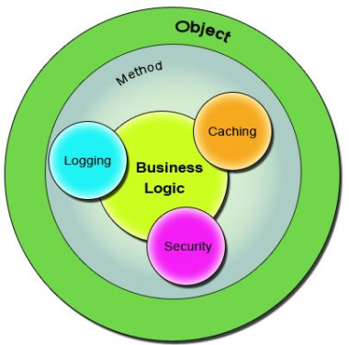
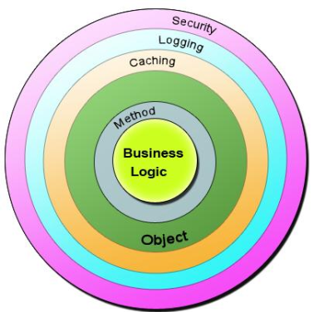
Bean in Spring container
Standard OOP implementation
Implementation with AOP
Spring Framework - AOP

Slide 34
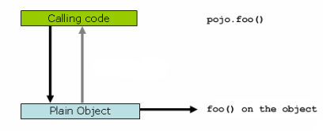
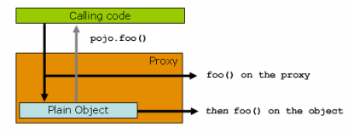
AOP proxies
Invoke directly
Invoke via proxy
Spring Framework - AOP

Slide 35
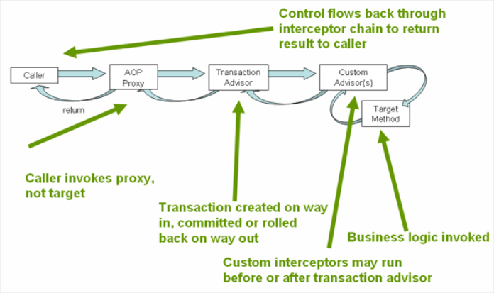
How it really works
Spring Framework - AOP

Slide 36
Introductions
Spring Framework - AOP

Slide 37
Introduction behaviors to bean
@Aspect
public class
CalculatorIntroduction {
@DeclareParents( value = "calculator.ArithmeticCalculatorImpl", defaultImpl = MaxCalculatorImpl.class) public MaxCalculator maxCalculator;
@DeclareParents( value = "calculator.ArithmeticCalculatorImpl", defaultImpl = MinCalculatorImpl.class)
public MinCalculator minCalculator;
}
Spring Framework - AOP

Slide 38
Introduction states to bean
@Aspect
public class BankServiceIntroductionAspect { @DeclareParents( value="bank.BankServiceImpl", defaultImpl=DefaultCounterImpl.class) public Counter mix;
@Before("execution(* get*(..)) && this(auditable)") public void useBusinessService(Counter auditable) { auditable.increment(); }
}
Spring Framework - AOP
Dmitry Noskov

Slide 39
Spring AOP vs AspectJ
Spring AOP
AspectJ
no need for a special compilation process
support only method execution pointcuts
advise the execution of operations on Spring beans
need AspectJ compiler or setup LTW
support all pointcuts
advice all domain objects
Spring Framework - AOP

Slide 40
@AspectJ vs XML
@AspectJ
XML
has more opportunities, such as combine named pointcuts
encapsulate the implementation of the requirement it addresses in a single place
can be used with any JDK level
good choice to configure enterprise services
Spring Framework - AOP

